Slide 1
ID5841: Quantum Computing Lab
VQE approach to Prime Factorization
on IBM's Noisy Intermediate Scale Quantum Computer
Replication & Extension of Sobhani, Chai, Hartung, Jansen — Physical Review A 111, 042413 (2025)
Course project by Mrudula A Mahindrakar, EE25S011
253
1048561
CVaR
2
Largest n
(real hardware)
On a classical
computer
Cost function
optimised
Optimizers
(COBYLA & NFT)
DOI: 10.1103/PhysRevA.111.042413

Slide 2
Motivation & Background
The Factorization Problem
• Classically hard — basis of RSA cryptography
• Shor's algorithm gives exponential speedup
• Largest factored by Shor on real hardware: 21
NISQ Era Approach
• NISQ devices: noisy, limited qubits, no error correction
• VQAs excel here: small circuits + classical optimizer
• VQE finds ground state of a Hamiltonian
This Work
• Encode factorization as: min (n − pq)²
• CVaR-VQE on IBM hardware & simulator
• No arithmetic simplifications — fairest benchmark
Factorization Records
21
Shor on real hardware
2021
291,311
Adiabatic (NMR, 3 qubits)
2017
1,829
QITE on IBM (9 qubits)
2021
253
VQE — this paper (9 qubits)
2025
1,048,561
VQE — ideal simulation
2025

Slide 3
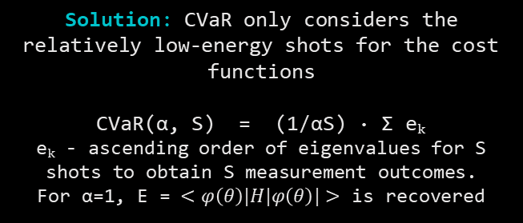

Method: CVaR-VQE Pipeline
1
2
3
4
Hamiltonian
Ansatz
CVaR
COBYLA
Encode (n−pq)² into
Pauli-Z operators.
Strip fixed LSBs p₀=q₀=1
to minimise qubit count.
Hardware-efficient
linear-CNOT circuit.
L layers of RY gates
+ CNOT chain.
Take lowest α-fraction
of shot eigenvalues.
α=0.01 outperforms
simple expectation.
Gradient-free simplex
optimizes θ params until it converges or reaches
max iters = 50·N·L
The problem with a standard VQE –
It calculates the average of all measurement values into the energy function $<H>.$
Standard averages can lead to Barren Plateaus, where optimisers may fail.
Solution: CVaR only considers the
relatively low-energy shots for the cost functions
CVaR(α, S) = (1/αS) · Σ eₖ
eₖ - ascending order of eigenvalues for S shots to obtain S measurement outcomes.
For α=1, E = $<φ\left(θ\right)|H|φ\left(θ\right)|>$ is recovered

Slide 4
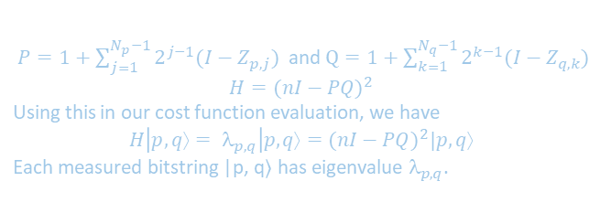
CVaR with small α maximises the chance of observing the correct factors in at least one shot — the natural metric for the factoring problem.
Cost Function Evaluation
Hamiltonian Eigenvalues · CVaR · Shot-Based Optimisation
Step 1 — Constructing the Hamiltonian
Why CVaR Instead of ⟨H⟩?
$P=1+\sum_{j=1}^{N_{p}−1}{2^{j−1}(I−Z_{p,j})}$ and $Q=1+\sum_{k=1}^{N_{q}−1}{2^{k−1}(I−Z_{q,k})}$
$$H={(nI−PQ)}^{2}$$
Using this in our cost function evaluation, we have
$$H\left|p,q⟩= λ_{p,q}\right|p,q⟩={(nI−PQ)}^{2}|p,q⟩$$
Each measured bitstring |p, q⟩ has eigenvalue $_{p,q}$.
Consider factoring n = 9:
|ψ₁⟩ = √0.9|00⟩ + √0.1|11⟩
⟨H⟩ = 57.6 | CVaR(0.1) = 0.0 ✓
10% chance of correct answer
|ψ₂⟩ = √0.5|01⟩ + √0.5|10⟩
⟨H⟩ = 36.0 | CVaR(0.1) = 36.0 ✗
0% chance of correct answer
Step 2 — CVaR Cost Function
The quantum circuit is measured S times, producing S eigenvalues {e₁, e₂, … eₛ}. Sort the S eigenvalues in ascending order.
Take the mean of only the lowest α·S values:
Classical VQE prefers |ψ₂⟩ (lower average energy) but CVaR correctly identifies |ψ₁⟩ as better — it has a 90% chance of yielding the solution in a single measurement.
CVaR(α, S) = (1/⌊αS⌋) · Σ eₖ [k=1..⌊αS⌋]
Bitstring Encoding |p, q⟩
Choosing α — The Tradeoff
State: |pNp−1… p₁ qNq−1… q₁⟩ with p₀ = q₀ = 1 implicit.
Example: |010001⟩ → p = 0101 → p=5, q = 0011 → q=3
Ground state of H if n = 15, since (15 − 5×3)² = 0
Smaller α → focuses on lowest-energy shots → better for finding the solution. But α→0 makes the landscape discontinuous and the CVaR estimate noisy

Slide 5
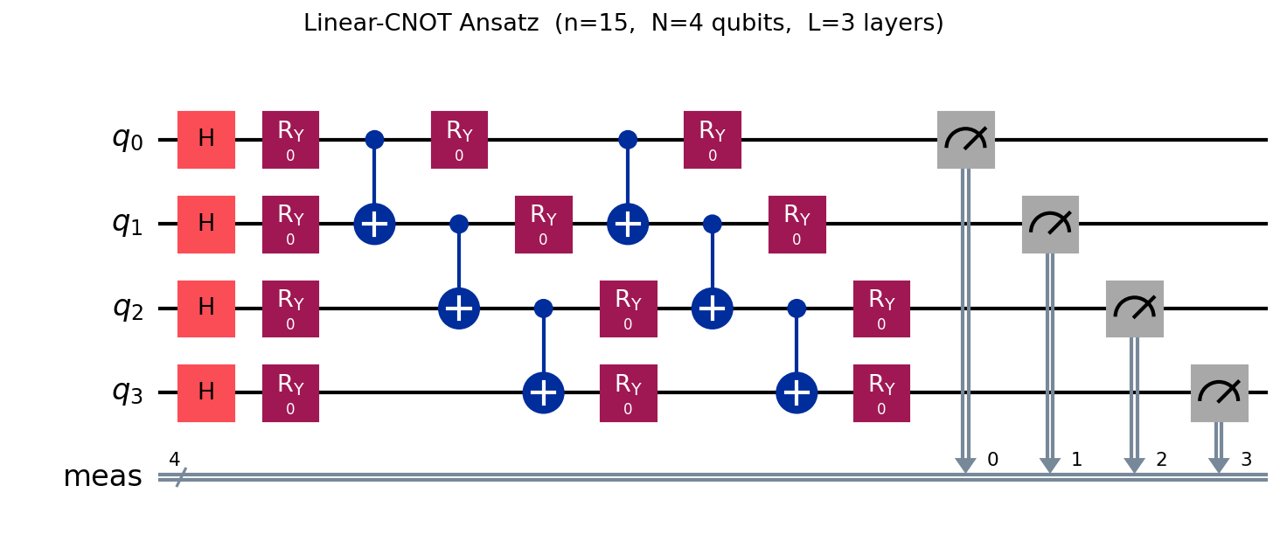
Linear-CNOT Ansatz Architecture
H
Hadamard Init
Start in equal superposition |+⟩^N
Rᵧ
RY Rotations
N·L variational params θ ∈ (−π, π)
CX
CNOT Chain
(N−1)·(L−1) entangling gates
M
Measurement
S shots → bitstring → (p,q) candidate
FIG. 2. Linear-CNOT Ansatz for L = 3.
N = ($N_{p}$ − 1) + ($N_{Q}$ − 1) free qubits | p ≤ √n → $N_{p}$ = ⌈log₂(√n)⌉ | p ≤ q

Slide 6
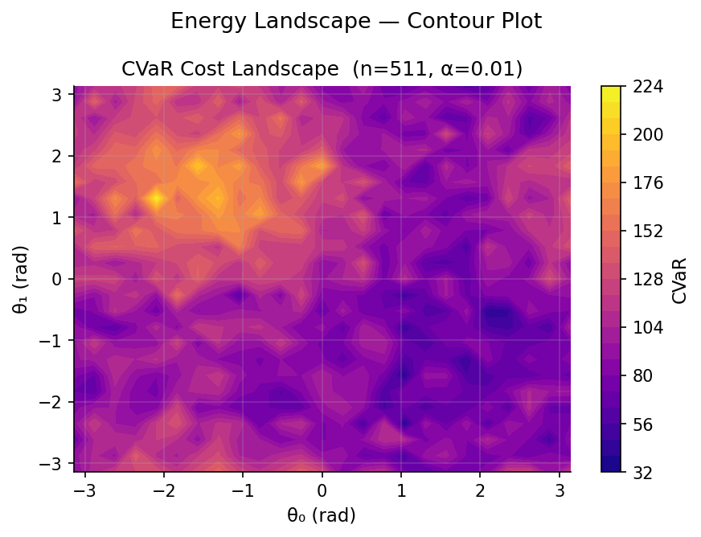
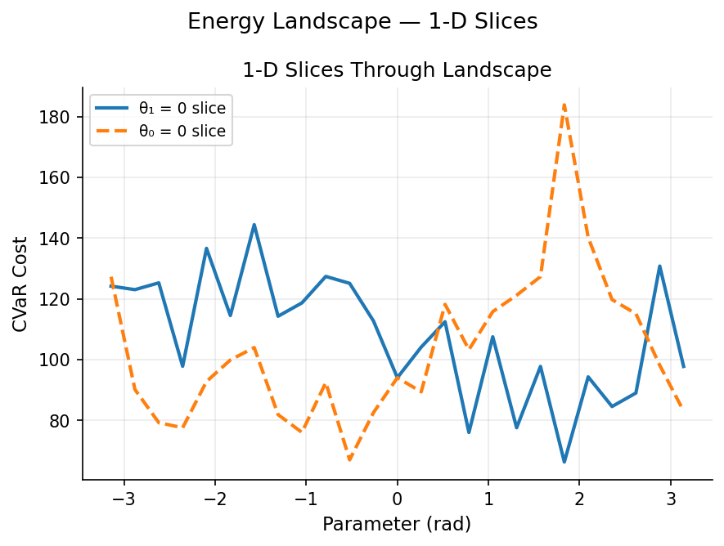
CVaR Energy Landscape
Extremely rugged surface — hallmark of barren plateau
Low-cost basins are tiny, isolated — no smooth funnel
1D slices oscillate 10–15× within a fraction of a radian
Notes:
The energy surface for this problem is extremely rugged and oscillatory, with low-cost basins being tiny and isolated. This confirms why sophisticated optimizers like COBYLA and NFT are necessary.

Slide 7
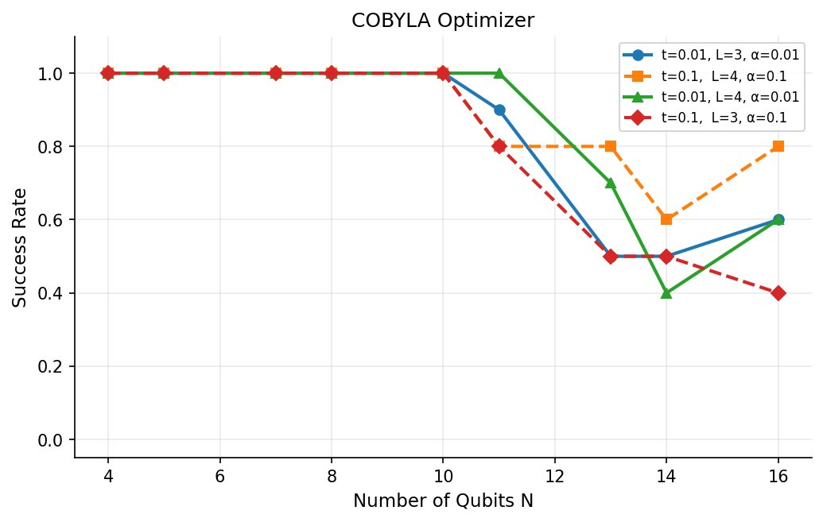
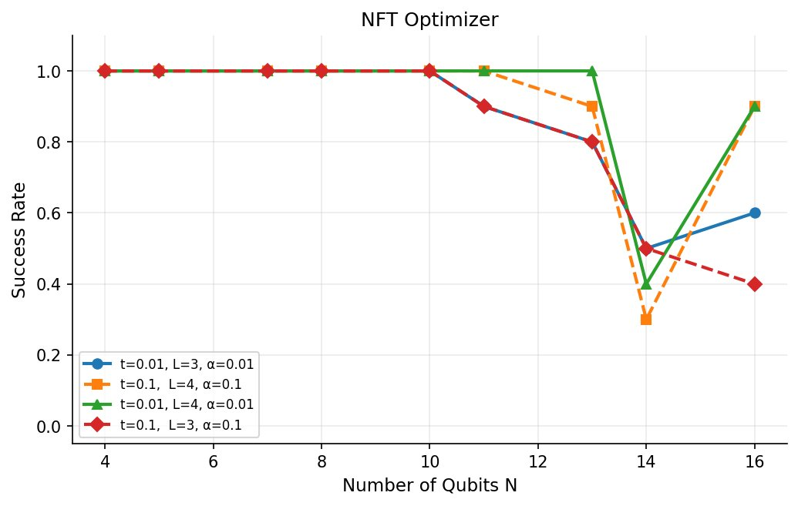
Success Rate vs Problem Size
COBYLA Optimizer
NFT Optimizer
FIG. 3. Success rate for largest numbers n requiring N qubits
100% success for N ≤ 10 qubits with both optimizers.
NFT clearly outperforms COBYLA at N ≥ 13.
Anomaly: Both optimizers’ performance dip at N = 14.
α = 0.01 dominates α = 0.1 throughout.
L = 4 has better success rate compared to L = 3 in both cases

Slide 8
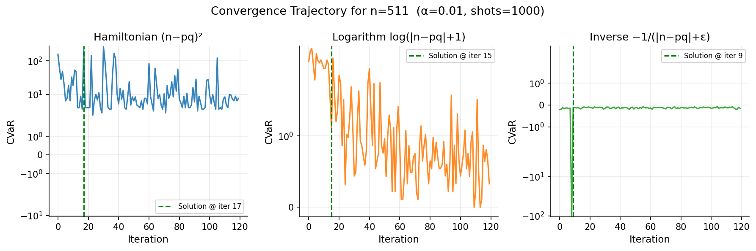
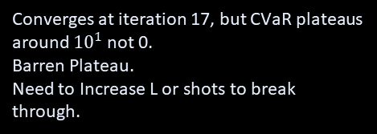
Cost Function Convergence (n=511, 10k shots)
⟶ 1000 shots: solution found early but CVaR continues to bound - inverse cost locks in fastest.
Hamiltonian (n−pq)²
Logarithm log(|n−pq|+1)
Inverse −1/(|n−pq|+ε)
Converges at iteration 17, but CVaR plateaus around ${10}^{1}$ not 0.
Barren Plateau.
Need to Increase L or shots to break through.
Finds solution at iter 15.
CVaR descends but remains noisy.
Best pairing with COBYLA with moderate shot counts.
Reaches solution earliest at iter 9.
CVaR is most stable post-convergence.
Fastest with NFT optimizer.
Notes:
Looking at the Hamiltonian and logarithm, we notice that it does find the solution in one of its samples, but the cvar fluctuates highly and dosent converge to 0. however inverse cost function not only finds the solution faster but also stays stable wrt the cvar.

Slide 9
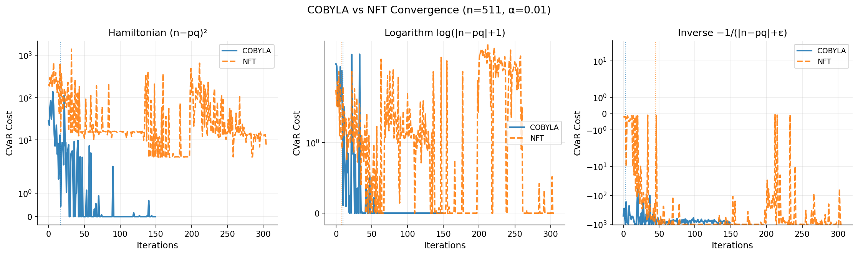
Optimizer Comparison: COBYLA vs NFT (n = 511)
Hamiltonian
Logarithm
Inverse
COBYLA wins decisively here, reaching near-zero cost in under 50 iterations.
NFT struggles remaining at a higher average cost floor even after 300 iterations. .
Both algorithms reach the bottom, but NFT takes much longer to "settle," with massive cost spikes occurring as late as iteration 250.
Both algorithms drop to the minimum.
NFT still experiences significant spikes around iter 225, whereas COBYLA remains flat at the bottom.

Slide 10
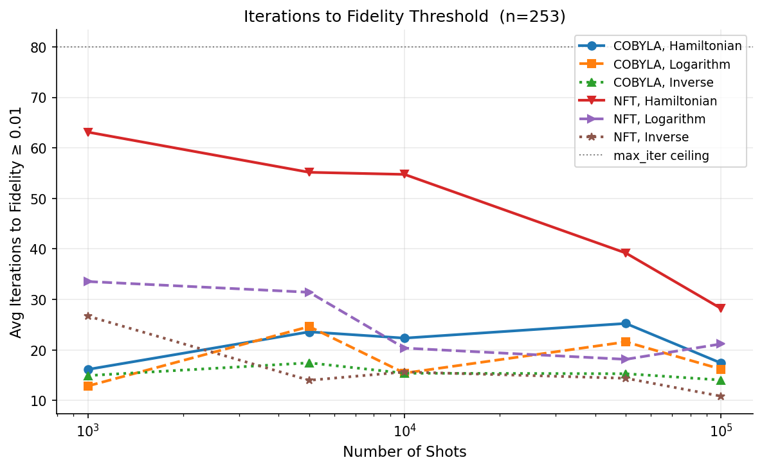
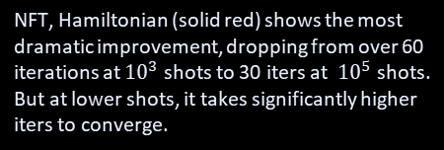
Iterations to Fidelity Threshold (n = 253)
Inverse + NFT wins long-term
NFT + Inverse (brown dashed) consistently reaches fidelity in ~10–15 iters across all shot counts, and improves as shots increase. Most reliable combination overall.
COBYLA + Inverse stable
COBYLA, Inverse (green triangles) shows remarkable stability, maintaining a low iteration count ~15 regardless of the number of shots.
NFT + Hamiltonian improves majorly, but is inefficient at lower shots
NFT, Hamiltonian (solid red) shows the most dramatic improvement, dropping from over 60 iterations at ${10}^{3}$ shots to 30 iters at ${10}^{5}$ shots.
But at lower shots, it takes significantly higher iters to converge.
FIG. 10. Number of iterations required to reach the ﬁdelity threshold for the successful runs, with various types of cost functions and using COBYLA or NFT optimizers.
max_iter ceiling (dotted line = 80)

Slide 11
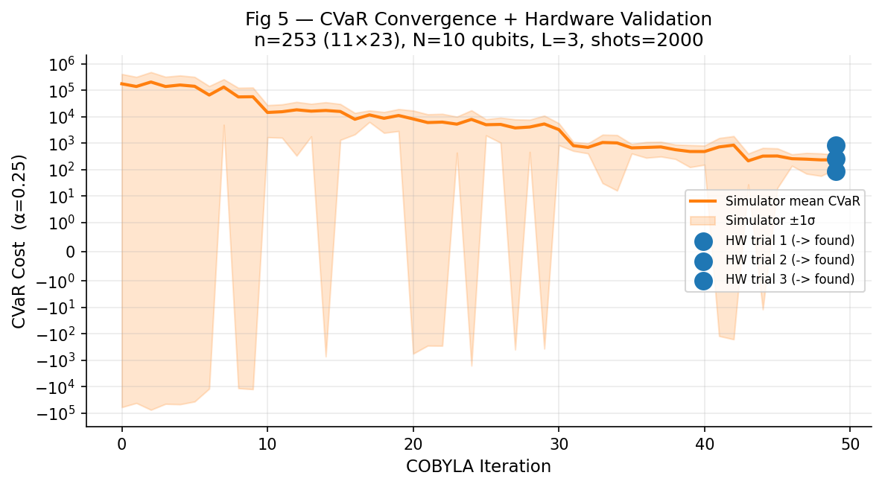
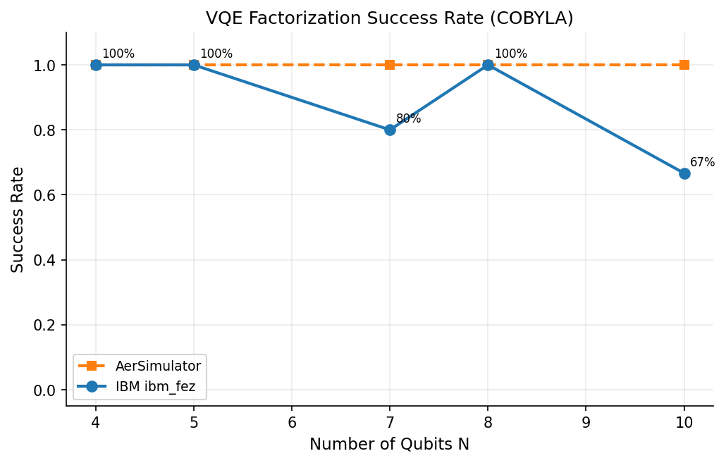
Hardware Results – IBM fez vs Simulator
n = 253 (11×23) · N = 10 qubits · ibm_fez · shots = 2000
15
21
123
57
253
▼
n=253 drops to 67% on hardware.
FIG. 5. Hardware run for n = 253, three layers, α = 0.25, 2000 shots requiring ten qubits.
▲
Noise gap at N=7.
Gate error accumulates with circuit depth.
Simulator envelope (±1σ)
Hardware trials (blue dots)
Orange band shows run-to-run variance across multiple simulator trials. Wide band at early iters reflects sensitivity to random initial parameters.
All 3 IBM ibm_fez trials found the solution (11×23). Final CVaR values land within the simulator ±1σ band — hardware noise is not catastrophic.
★
Hardware result confirms the paper's core claim: VQE factorization is viable on real NISQ devices up to n=253.

Slide 12
Key Findings & Next Steps
What We Found
Future Work
✓
α = 0.01 outperforms α = 0.1 even with finite shots — contrary to naive intuition
1
Warm-Start Initialization for Inverse Cost Functions
NFT beats COBYLA at N ≥ 13 and with inverse cost function
The paper identifies - finding good initial parameters for the inverse-type cost as an open problem.
✓
✓
CVaR effectively overcomes Barren Plateaus by focusing on low energy shots
2
Barren Plateau Mitigation
✓
Inverse cost function may suffer from barren plateaus (exponentially vanishing gradients).
✓
10k shots creates a phase transition: chaotic → convergent optimization
3
Convergence Speed of Inverse Cost
✓
Hamiltonian cost plateaus at ~15 (barren plateau, not shot noise)
Inverse cost needs more iterations than Hamiltonian cost. A cost switching strategy by training one model and feeding the parameters to another model can help.
✓
Logarithm + COBYLA: best for moderate shot budgets
4
Generalization Beyond QUBO
Inverse + NFT: fastest convergence at 10k+ shots
The warm-start technique showing improvement in QUBO problems is referenced but its extension to inverse-type costs is explicitly left open.
✓

Slide 13
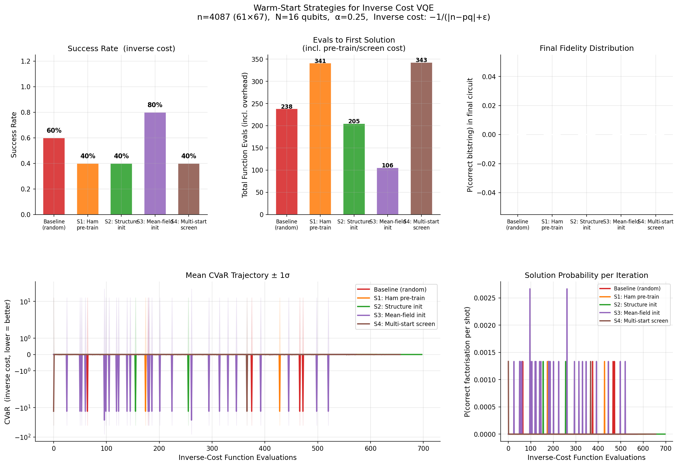

Warm start strategies
BL
Baseline (Random Init)
Reference
→ n = 4087 = 61×67 · N = 16 qubits · $α$=0.25 · 5 independent runs
Random angles drawn from U(−π, π). No prior knowledge. Used as the reference.
S1
Hamiltonian Pre-train
Cost Switching
Short COBYLA run on the squared-error Hamiltonian cost (easier landscape) → transfer final params to inverse-cost optimisation.
S2
Structure-Inspired Init
Analytical Bias
Layer-1 RY angles analytically biased toward p ≈ √n in binary. q-register set to uniform superposition (π/2). Deeper layers perturbed ±0.25.
S3
Mean-Field Init
★ Best Strategy
S3 : Solves a classical approximation of the problem first → Estimate the probability of each bit being 0 or 1 → Ignore correlations between qubits → Choose probabilities that minimize the expected cost → Convert probabilities to rotation angles $θ=\sin^{−1}\left(\sqrt{p^{∗}}\right.$ → Use these angles as initial parameters for VQE
Classical mean-field optimisation over product-state marginals P(qubit=1). RY angles set to 2·arcsin(√p*). Best of 8 restarts selected.
S4
Multi-Start Screening
Screening
Reference: Y. Chai, K. Jansen, S. Kühn, T. Schwägerl, and T. Stollenwerk, Structure-inspired ansatz and warm start of variational quantum algorithms for quadratic unconstrained binary optimization problems, arXiv:2407.02569.
K=8 random starts, each run for 20 Hamiltonian-cost iterations. Best-scoring candidate params passed to full inverse-cost optimisation.

Slide 14
Thank You
VQE Prime Factorization — Replication & Extension Study
Sobhani, Chai, Hartung, Jansen — Phys. Rev. A 111, 042413 (2025)
DOI: 10.1103/PhysRevA.111.042413

